Slide 1

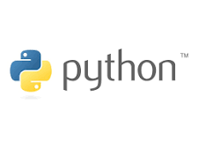

Introduction to programming
(Python)
Session 1
Lecture : Ms. LAVANYA MOHAN
Contact Details :lavanya@metaverseage.ae

Slide 2
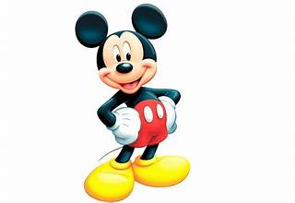
What you think About Programming Language ?

Slide 3
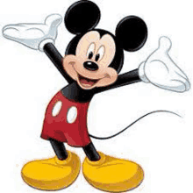
A programming language is a formal set of instructions or code that humans use to communicate with computers

Slide 4

What are the Programming languages name you know ?

Slide 5
● Logic & Algorithmic thinking
● Version control basics
● Data Types
● Basic user interactivity
● Operators
● Conditional statements (if, if-else, switch)
● Control flow statements (while, do-while, for)
● Numbers, Strings
● Tuples, Sets
● Arrays
● Functions (passing in, returning out)
Unit Content

Slide 6
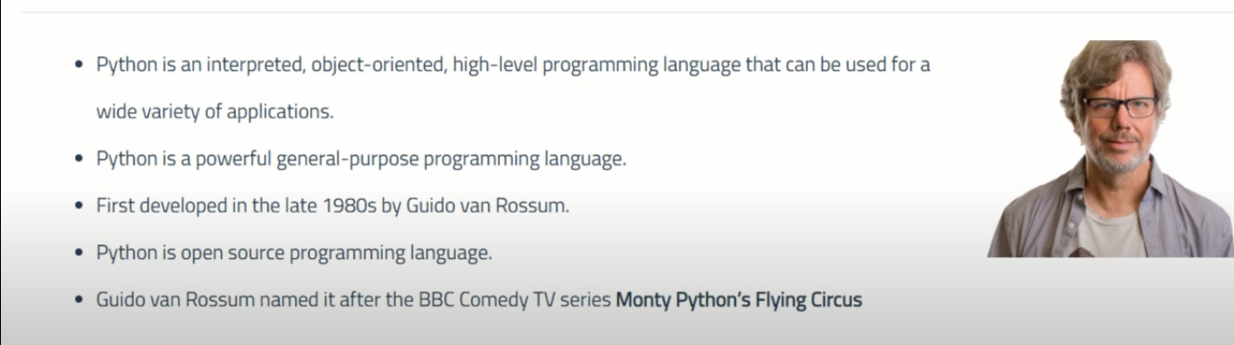
Introduction Programming(python)
First developed in the late 1980s by Guido van Rossum
First public release(USENET)-Feb 1991
Python.org website 1996 or 1997
Python software foundation-2001
Guido van Rossum named it after the BBC comedy TV series Monty python’s Flying Circus

Slide 7

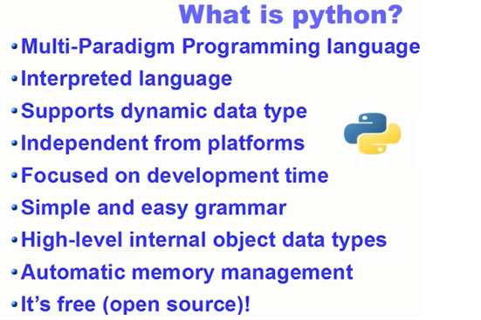
Python

Slide 8
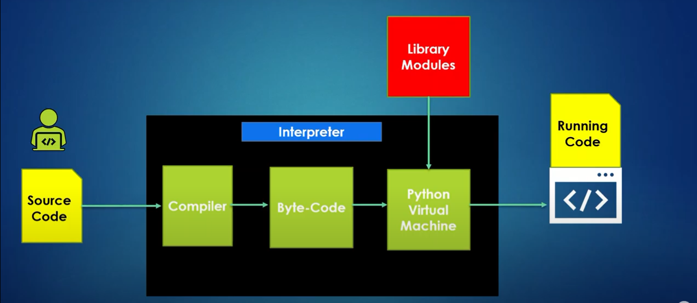
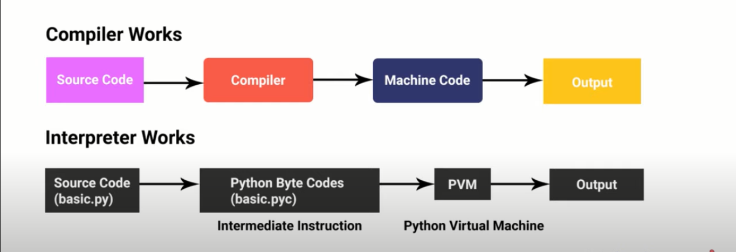
Difference between
Compiler and Interpreter

Slide 9
Python is easy to learn and use
Large number of libraries available that can be used in your project today
High level programming language
Object-oriented language
Portable across operating system
Advantage of python programming

Slide 10
Python Editors
anaconda.com/product/individual
python.org/downloads/
Visual studio 2020
Eclipse
Online Compiler =>repl

Slide 11
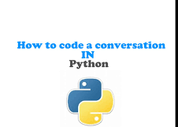
Have a conversation with Python
#Python is good in understanding expression
Commands that Python Understand & don’t understand
hello
‘hello
‘hello’
“hello”
‘hello’’world’
‘hello’’ ‘’world’
‘hello world’
‘hello’-’world’
#run and see the output

Slide 12
Have a conversation with Python
#Python is good in understanding expression. You can use Python instead of calculator
Commands that Python Understand & don’t understand
2
2+
2+2
2+3*2
(2+3)*2
#Run and see the output

Slide 13
Have a conversation with Python
#Commands that Python Understand & don’t understand
‘hello’+’2’
‘hello’+2
‘hello’*2
‘hello’*3
‘hello ‘*3
‘hello’*’3’
hello’-’3’
‘hello’/’3’
Run and see the output

Slide 14
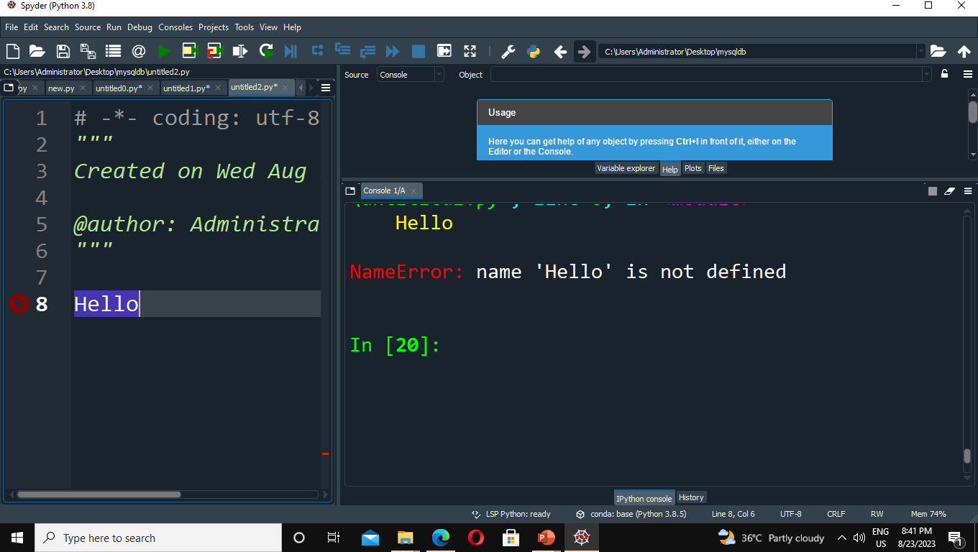
Conclusion
Python is a scripting Programming language
If it understands the command, then it runs, otherwise it tells us that it can’t understand (in red text)

Slide 15
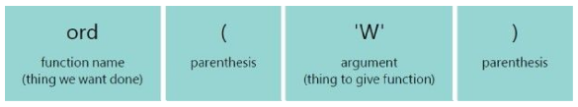
Work with python function
Ordinal value Functions- ord function
Gives the number that represents a character
Function call- ord(‘W’)
Here W is a part of string and must be inside single quotes. Try without quotes also to see the result.
Print(‘hello’)

Slide 16
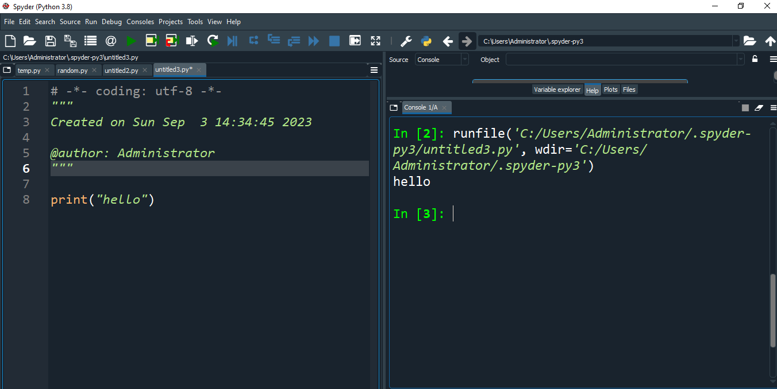
Print(‘hello)

Slide 17
Exercise
Print
He said, "JavaScript is awesome" I replied,
‘Python is more awesome’

Slide 18
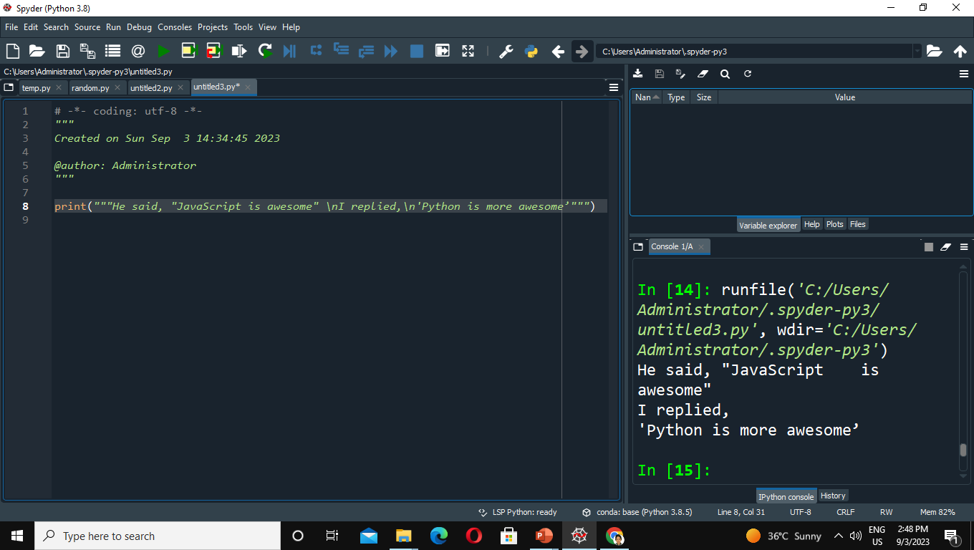
Answer

Slide 19
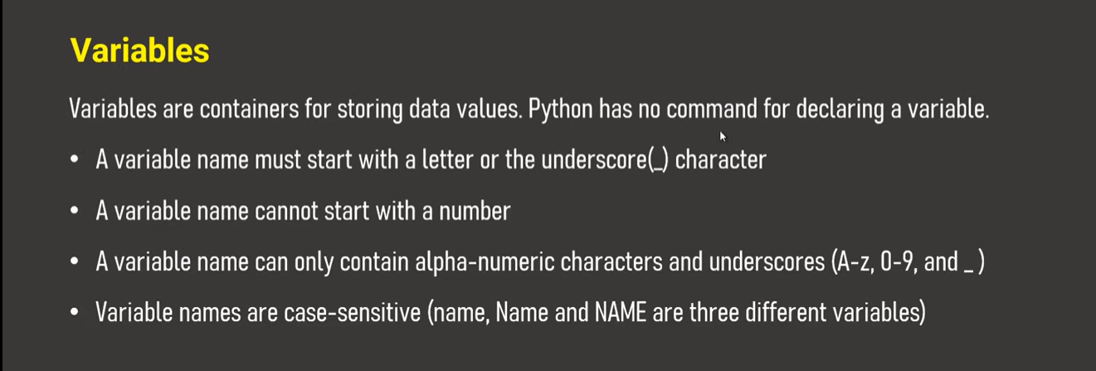
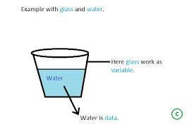

Slide 20
Create Variable then store your name , age, city, gender and print
Exercise

Slide 21
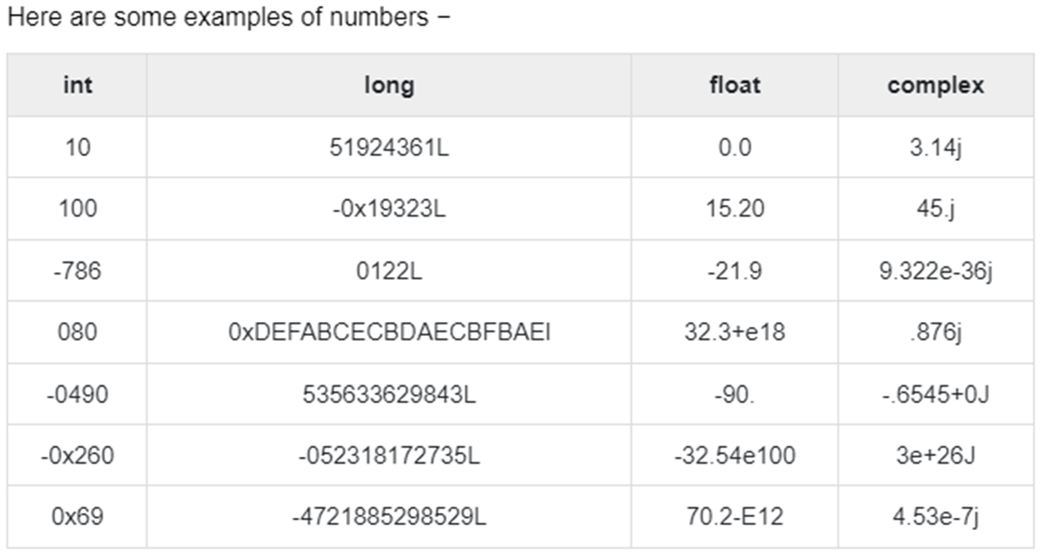
Integer =2528
Float=2.5
String=“hello”
Boolean=True or false
Data types

Slide 22
Int 2 or 5 bytes a=5
Float 4 bytes b=2.5
String A fixed-length string can contain 1 to approximately 64 K
(2^16) characters d=“hello”
Boolean Boolean 2 bytes true/false E.x A=true
Ranges

Slide 23
Sequence Data types
Tuple
E.x X=(“apple”, ”banana”, ”orange”) parentheses
LIST
E.x X=[“apple”, ”banana”, ”orange”]square bracket
Set
E.x X={“apple”, “banana”, “orange”}curly braces

Slide 24
Complex
d=1j (number +alpha)
Frozenset
H=({“apple”, ”banana”, ”orange”})

Slide 25
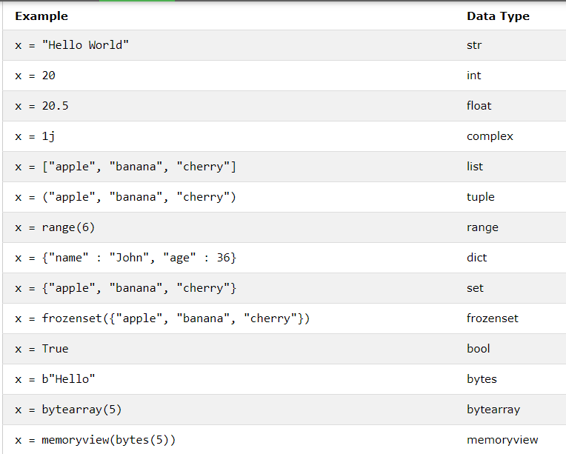

Slide 26
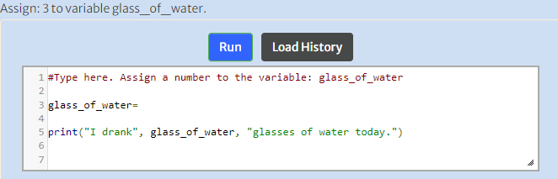
Mixing Number and text
Add 2 more glass of water & run
Printing Integer and Strings

Slide 27
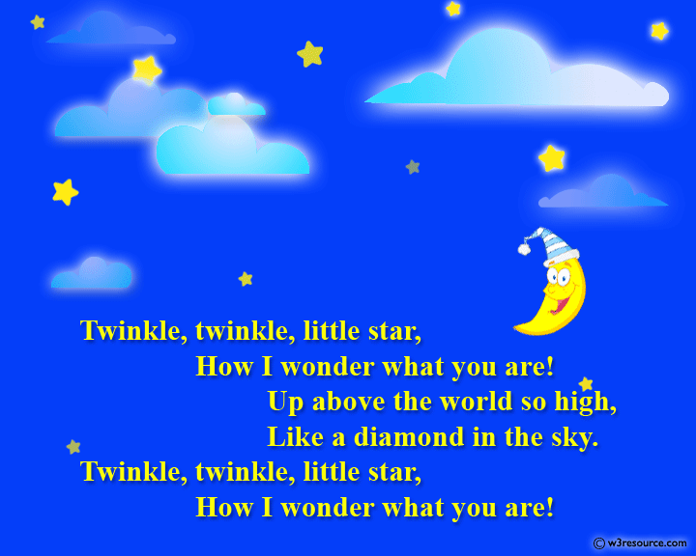
Print the Following poem

Slide 28
How to get user input
Integer input A=Int(input(“Enter your number”))
String input B=(input(“Enter your name”))
Decimal point C=Float(“Enter your decimal number”)

Slide 29
Get name, age,city,gender from user and print
Exercise

Slide 30
Answer
print("Twinkle, twinkle, little star, \n\tHow I wonder what you are! \n\t\tUp above the world so high, \n\t\tLike a diamond in the sky. \nTwinkle, twinkle, little star, \n\tHow I wonder what you are!")
Output
Twinkle, twinkle, little star,
How I wonder what you are!
Up above the world so high,
Like a diamond in the sky.
Twinkle, twinkle, little star,
How I wonder what you are!

Slide 31
Print version of Python
import sys
print("Python version")
print (sys.version)
print("Version info.")
print (sys.version_info)

Slide 32
Display the current date and time.
import datetime
now = datetime.datetime.now()
print ("Current date and time : ")
print (now.strftime("%Y-%m-%d %H:%M:%S"))
Current date and time :
2023-09-04 15:37:28

Slide 33
Write a Python program that accepts the user's first and last name and prints them in reverse order with a space between them
fname = input("Input your First Name : ")
lname = input("Input your Last Name : ")
print ("Hello " + lname + " " + fname)
Output
Input your First Name : lavanya
Input your Last Name : mohan
Hello mohan lavanya

Slide 34
Thank You

